Slide 1
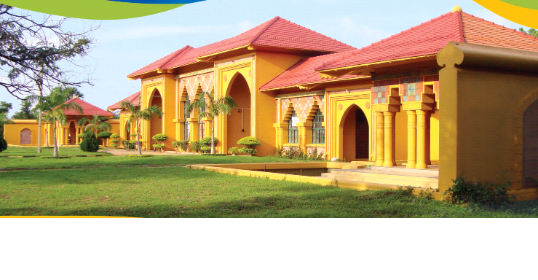
Sociological Impacts of Covid19 on Sri Lankan Society
DDr/Dr.A.Rameez, B.A(SEUSL),PGD(UoB-UK), M.Phil(PDN), Ph.D(NUS, Singapore)
Senior Lecturer in Sociology
SEUSL
Dr.A.Rameez,Ph.D(NUS,Singapore)
Senior Lecturer in Sociology, Grade I
Dean, Faculty of Arts and Culture
South Eastern University of Sri Lanka

Slide 2
Outline of the presentation
Covid19 pandemic and global society
Covid19 and its impacts on Sri Lanka
Sociological Impacts of Covid19 on Sri Lankan society
Positive dimensions of Covid19 upon Sri Lankan society
Conclusions
Questions and answers

Slide 3
Covid19 pandemic and global society
Novel Covid19 first identified in Wuhan in December 2019
Then, WHO declared it as a global pandemic on 11th March 2020
According to WHO, mortality rate of Covid19 is lower than that of SARS(Severe Acute Respiratory Syndrome) and MERS(Middle East Respiratory Syndrome)
Nevertheless, infection rate of Covid19 is double than that of SARS and 5 times higher than seasonal flu.
Govts across the world have resorted to varying measures including
movement restrictions,
nationwide curfews,
travel bans and
border closures to tackle the pandemic
It is not only a health issue, but social(families, social issues), economical issues(national economies, global trade, tourism sector), because its effects rises steadily of unprecedented proportions( 6.7 million cases with almost 400,000 deaths)

Slide 4
Covid19 and Sri Lanka
Total cases | Total deaths | Total recoveries | Total cases I million Pop | Total deaths I million Pop | Test per day I million pop | Total pop(Million)
1,797- Sri Lanka | 11 | 839 | 84 | 0.5 | 3,372 | 21
1,924,0510- United States | 110,173 | 712,252 | 5,815 | 333 | 59,142 | 330
226,770- India | 6,363 | 109,462 | 164 | 5 | 3,181 | 1379

Slide 5
Continue…
First case of Covid 19 was detected in 27th January and treated at IDH
First case of local( tourist guy) was detected in February
Task force under military and health authorities has been constituted to fight against Covid19
Govt has declared lockdowns/curfew across the government on March 19
Govt has established 45 quarantine center under Army
Life of all the people has come to a grinding halt/standstill with economy massively hit
Sri Lanka has been ranked 9th best country in the world for its successful immediate response on tackling the virus

Slide 6
Sociological Impacts of Covid19 on Sri Lankan society
Impact on social capital and interaction- Social distancing is a challenge to the core of social cohesion, people including migrants maintain their relations virtually. Apart from primary relationship, secondary relationship outside the world(with peers, colleagues) is centre of socialization/interaction.
Impact on family and community networks -Social interaction within family, neighborhood and in communities becomes distanced. Not being able to attend gym, workplace causes anxiety and frustration.
Impact on education- loss of student life in school and universities causes psychological issues. Children staying at home while parents at work causes problems( 1 billions students are out of school).
Social Problems/issues generated by COVID 19- resultant lockdown caused
domestic violence( 1938 help line) and intra and inter-family dispute
child abuse (1929 held line) both these help lines received 40% complaints
Poverty and alcoholism

Slide 7
Continue..
Economic Impact of COVID 19- Economic constrains due to lockdown , how people cope up with the economic issues/lack income, unemployment- sources of monetary support from govt, NGOs, charity etc
Impact on religious activities and rituals- Religious activities and rituals have come to a grinding halt, thus people did not know where to turn to address their problems and during crisis. Religious gatherings have stopped.
Impact on sports and leisure – lack out-door games/sport, how youth spent time, picnics/trips, parties, adventurism and so on have abruptly stopped.
Psycho-social impact of Covid 19- people have had psychological issues, stress, suicidal attempts or suicides etc. In India, suicide case is reported due to pressure to learn via online

Slide 8
Continue..
Social Media and Covid 19- The role of social media, what are main social media platforms used, what kind of messages promote, are they useful, how such social media messages help to keep safe? Etc
Impact on cultural and personal events- Deaths, marriages, weddings,-Apart from the mode of burial, do they avoid large gatherings, how weddings were conducted or postponed?
Impact on minority ethnic groups- bear the brunt of stigma, victimization, discrimination( India and SL). Xenophobia and racial profiling

Slide 9
Continue…
Impact on vulnerable groups- These groups suffer disproportionately due to lack of movement, few employment opportunities. They become desperate and involve in anti-social behavior( theft and burglary). It creates a sense of insecurity; insecurity breads conflict
Daily workers
Differently abled/ disabled-susceptible due to chronic diseases
Elderly
Migrant people- welfare issues, repatriation issues

Slide 10
Positive dimensions of Covid19 upon Sri Lankan society
Social distancing promote a disciplined society- queue,
Personal hygiene practices and wearing masks promote healthier society
Crisis ramped up philanthropy
Necessity/Crisis creates invention and innovation including online education
Exponential growth of population can be expected in times to come
Intra-familial bonds have ramped up during this crisis

Slide 11
Conclusion
Covid19 is a blessing in disguise for some, while it is a curse for many
However, it is a health crisis of unprecedented proportion
All the sociological issues are candid and warrant a serious concern and solution
It warrants us re-think/re-strategize our economy towards self-reliant or self-sufficient
Import needs to be curtailed, while exports of high quality products must be accelerated
Massive investment must be made in sectors like agriculture, industry( manufacturing), health and education in future.
As we may have to live with virus for another one or two years, may have to adjust our lives accordingly with health protocol in place, perhaps until a vaccine is invented.

Slide 12
Thanks

